Slide 1


Welcome to H.O.T. www.handsontech.org
Our Purpose:
Forum for interaction
Many hobbyists build/tinker in isolation
Make new friends with common tech interests
Learn together
Lots of fun new tech to explore
Share expertise, help each other
Build something
Hands-On learning
Make something fun & useful
Notes:
<number>

Slide 2



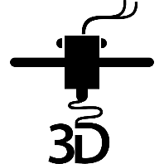
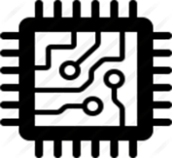
One Hands-On Tech club Two Groups
3D Printing
Small Computers
Notes:
<number>

Slide 3
New to the club? Welcome!
Wondering what H.O.T. is all about?
This is a hands-on group, so we may be in the middle of a series of meetings on our way to building something interesting
Go to handsontech.org>New Members for a specially designed launching point for new members!
Please take the time to look through a few presentations at handsontech.org>Small Computers or handsontech.org>3D Printing.
Presentations are always available online after our meetings for reference and as self-paced projects
Notes:
<number>

Slide 4
Club communications are via Email & Web !
To join our email list(s), fill membership form at handsontech.org>New Members
When asked for your email address, use a gmail email address if possible (we use google forums & they are picky)
You will be added automatically to our Hands-On Tech (H.O.T.) overall email list
You will also be added to the Small Computers and/or 3D Printing mailing lists and forums if you expressed interest in the membership form.
Meeting calendar is at handsontech.org
Notes:
<number>

Slide 5
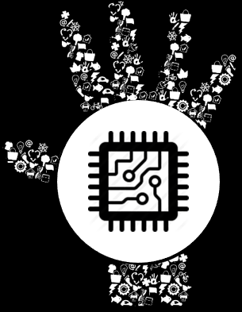

What Is ROS?
Notes:
<number>

Slide 6
Small Computers and Robots
Small Computers have become powerful enough to be capable of running ROS (The Robot Operating System).
Today, we will explore ROS by looking at how it is used to build a simple robot capable of autonomous navigation.
Notes:
<number>

Slide 7
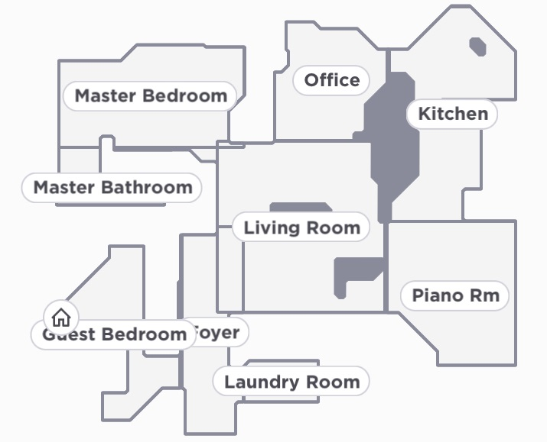
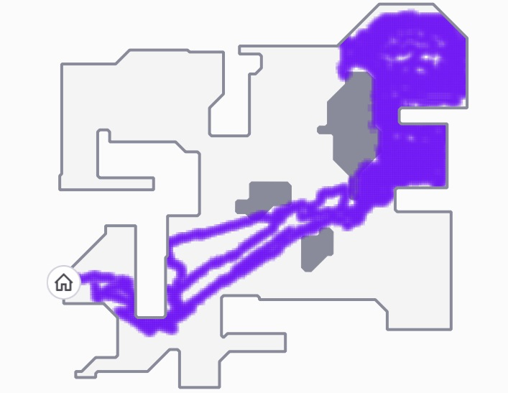
Look what my Ninja RVC can do
Map and navigate its environment
Notes:
<number>

Slide 8
Modern Robot Vacuum Cleaners
Can Map their environment
Can Localize themselves on map
Can plan their Path to goal pose
Can clean your house
Can find their way home to:
Empty dirt
Recharge
Notes:
<number>

Slide 9
Use ROS to build a robot that can...
Map its environment
Localize itself on map
Fuse sensor data (wheel odom & IMU)
Plan Path to goal pose
Clean the house
Avoid obstacles
Return home
Notes:
<number>

Slide 10
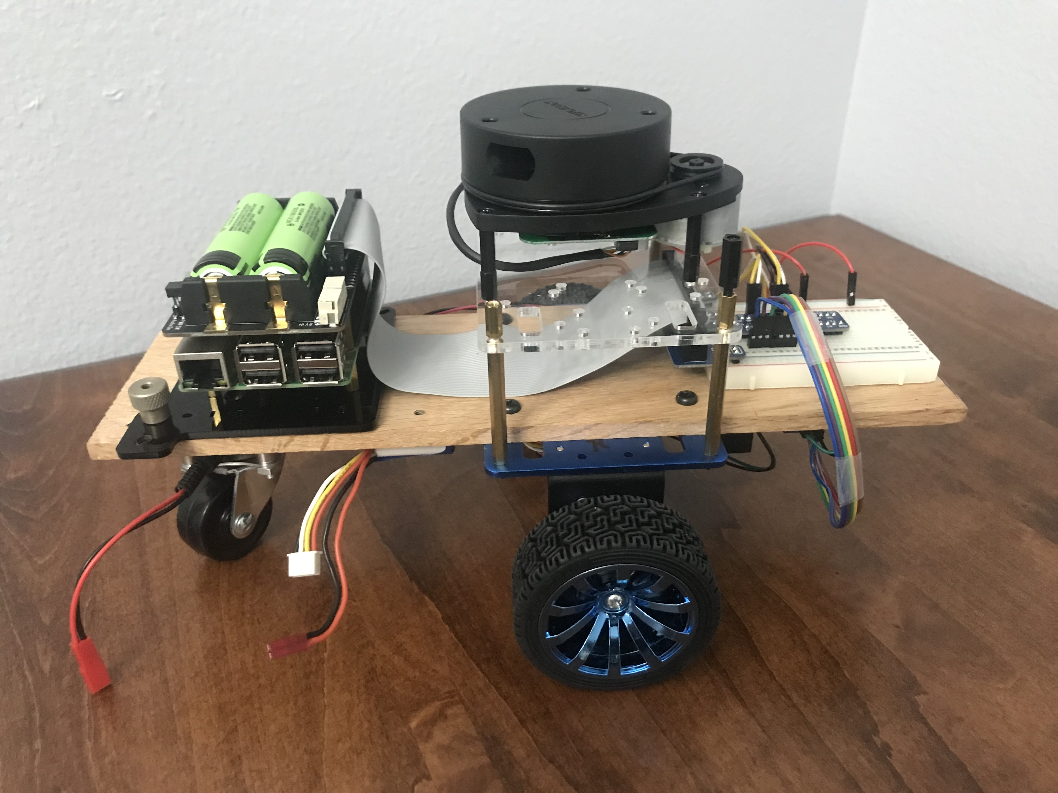
Let’s start simple...
Differential drive
Raspberry Pi 3B+
Geekworm UPS
RPLidar
Bosch BNO055 IMU
Notes:
<number>

Slide 11
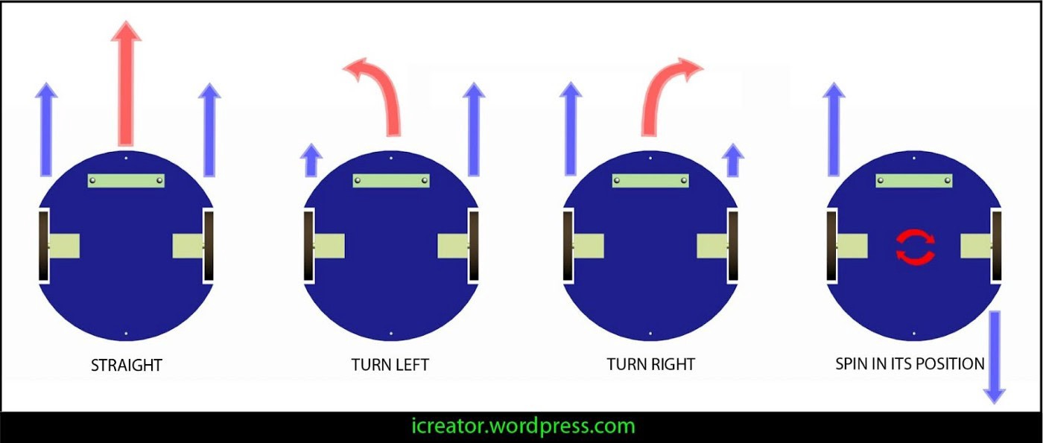
How Differential Drive Works
Notes:
<number>

Slide 12
What will ROS do (and what do we need to do)?
We will take care of the motor/encoder interface
We will let ROS do the rest:
Map the environment
Fuse wheel odometer and IMU data
Localize the robot on map
Plan the path to goal pose
Detect and avoid obstacles
Notes:
<number>

Slide 13
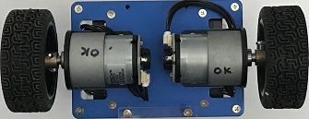
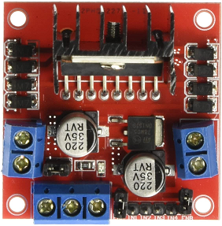
/right_ticks
/left_ticks
/act_vel
Odometry
Publisher
Encoder Publisher
/odom
/tf
Nodes
Communicate via
Topics
/cmd_vel
Motor Controller
Notes:
<number>

Slide 14
How ROS communication works
Roscore node is started first
Coordinates communication between nodes
Serves as master clock
Parameter server
Package manager
New nodes register with roscore
Specify topics they want to subscribe to
Specify topics they will publish
Notes:
<number>

Slide 15
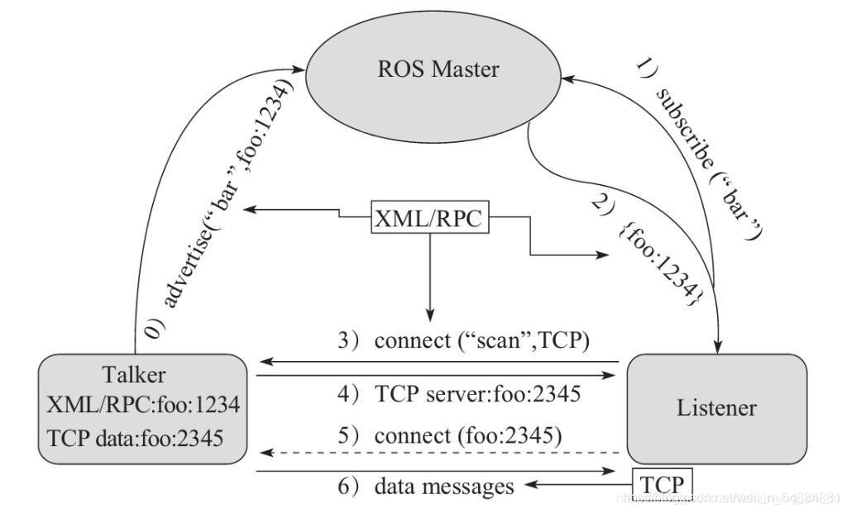
How ROS communication works
ROS communicates via TCP
Roscore is at ROS_MASTER_URI=http://raspi4:11311/
Notes:
<number>

Slide 16
/right_ticks
/left_ticks
/act_vel
Odometry
Publisher
Encoder Publisher
/odom
/tf
/cmd_vel
Motor Controller
Notes:
<number>

Slide 17
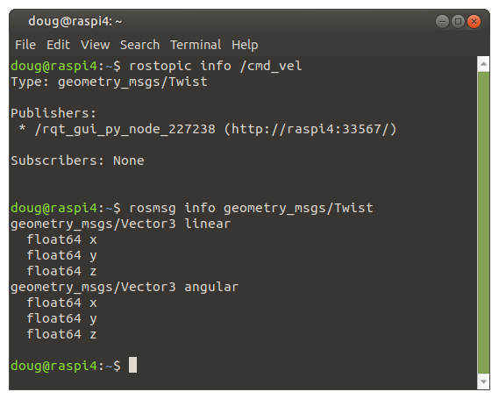
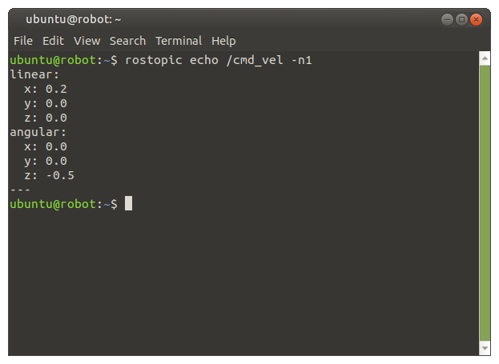
How ROS communication works
A Message is published over a channel called a Topic
Example: the /cmd_vel topic contains a Twist message
Notes:
<number>

Slide 18
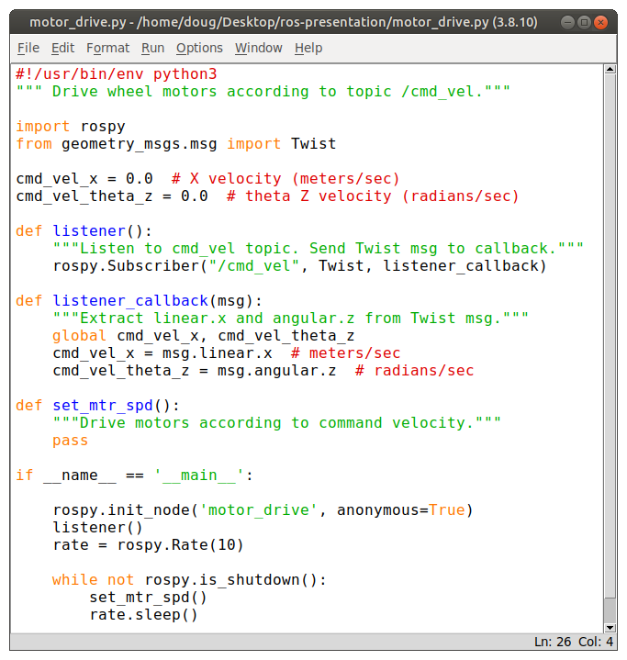
Motor Controller Node to drive motors
Import rospy, Twist
Register w/ roscore
Subscribe to /cmd_vel
Listener()
Listener_callback()
Set loop rate to 10 Hz
Drive motors
Notes:
<number>

Slide 19
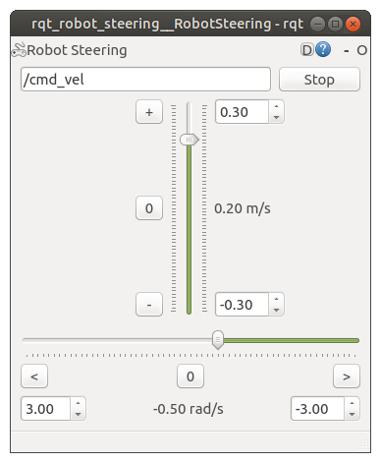
Robot Steering tool used to steer robot
Standard GUI tool
Command-line launched
User setable velocities
X (Linear)
Theta Z (Angular)
Publishes /cmd_vel @ 10 Hz
Notes:
<number>

Slide 20
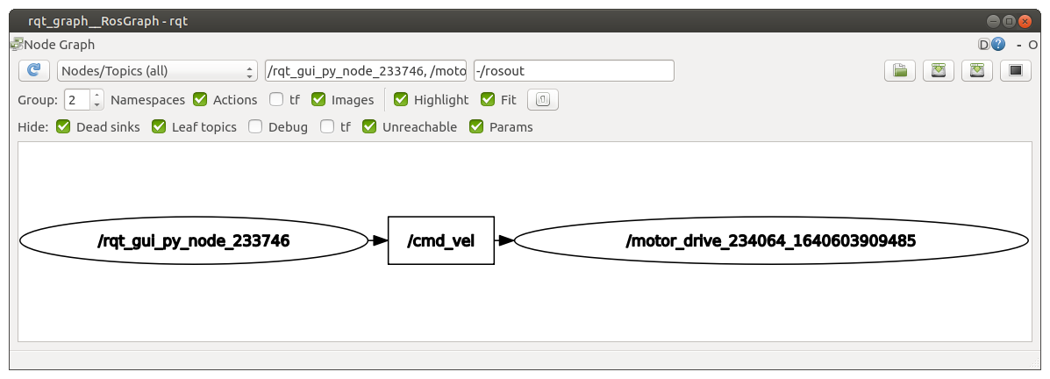
Use rqt_graph to show nodes / topics
Notes:
<number>

Slide 21
Let’s combine two nodes
Combine motor_controller and encoder_publisher functions into a single node
Notes:
<number>

Slide 22
/right_ticks
/left_ticks
/act_vel
Odometry
Publisher
Encoder Publisher
/odom
/tf
/cmd_vel
Motor Controller
Notes:
<number>

Slide 23
Odometry
Publisher
/odom
/tf
/right_ticks
/left_ticks
/act_vel
Motor_Encoder
/cmd_vel
Notes:
<number>

Slide 24
motor_encoder Node
motor_controller and encoder_publisher functions combined into a single node
Registers w/ roscore
Subscribes to /cmd_vel
Sends PWM signals to L298N motor driver
Counts encoder ticks and Publishes topics:
/right_ticks
/left_ticks
/act_vel
Notes:
<number>

Slide 25
Counting encoder ticks on RasPi
Use pigpio to give gpio pins super powers
All gpio pins enabled as interrupts
PWM output enabled on all pins
Notes:
<number>

Slide 26
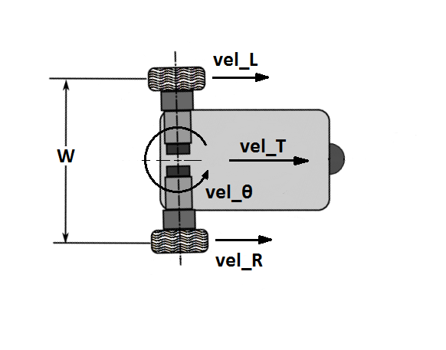
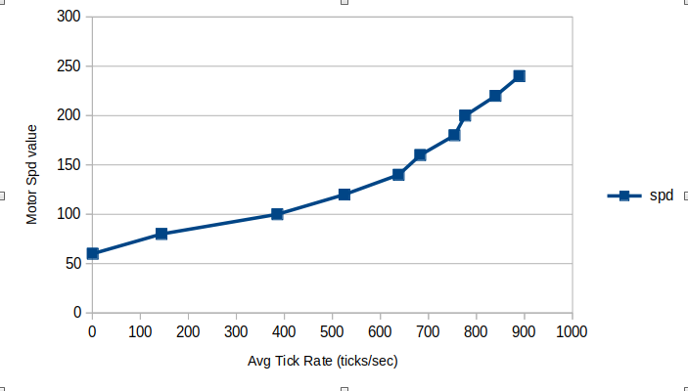
Drive motors from /cmd_vel
Find wheel velocity from /cmd_vel
vel_R = vel_T + (vel_Theta * W/2)
vel_L = vel_T - (vel_Theta * W/2)
For each wheel (motor):
Convert vel to tick rate
Convert tick rate to PWM value
error TR = target TR - actual TR
Use PID loop to trim PWM value
Send adjusted PWM value to motor
Notes:
<number>

Slide 27
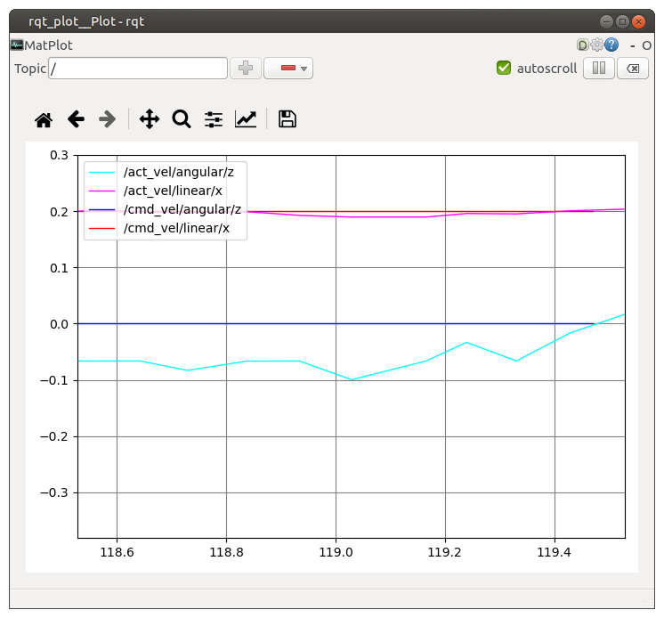
Test: Does /act_vel match /cmd_vel?
Notes:
<number>

Slide 28
odometry_publisher Node
Registers w/ roscore
Subscribes to topics:
/right_ticks
/left_ticks
/act_vel
Publishes topics:
/odom
Broadcasts /tf
Notes:
<number>

Slide 29
How Wheel Odometry Works
Use encoder pulses to dead-reckon
Robot’s position
Robot’s velocity
Find wheel velocity from /cmd_vel
vel_R = vel_T + (vel_Theta * W/2)
vel_L = vel_T - (vel_Theta * W/2)
Publish /odom
Broadcast /tf
Notes:
<number>

Slide 30
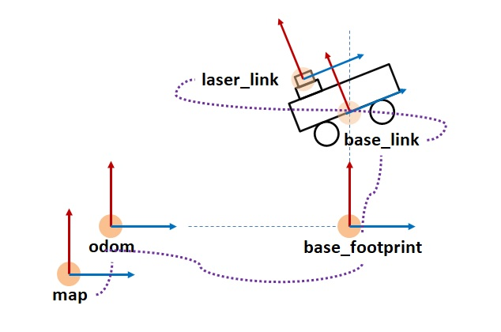
Coordinate Frames
Notes:
<number>

Slide 31
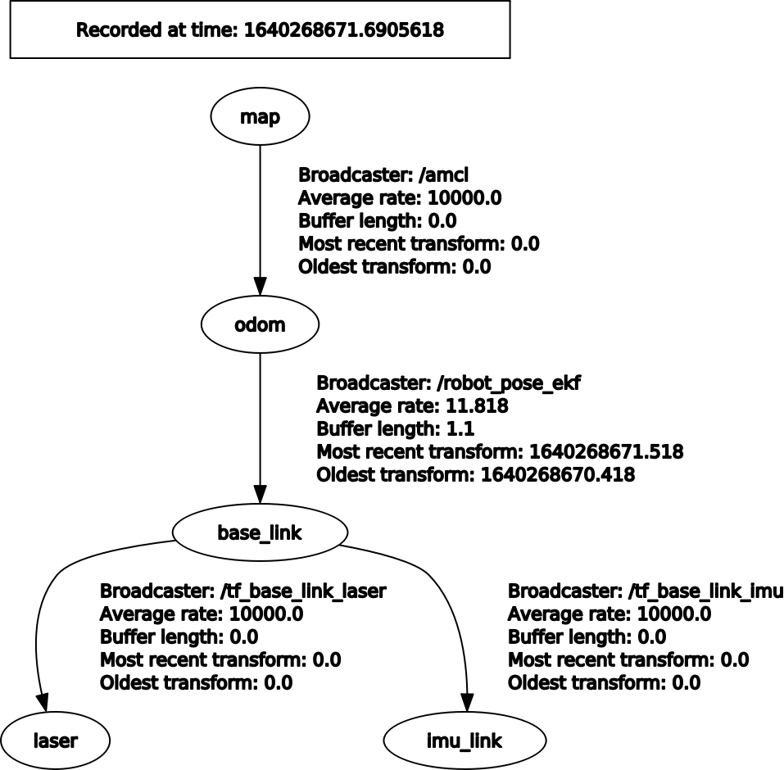
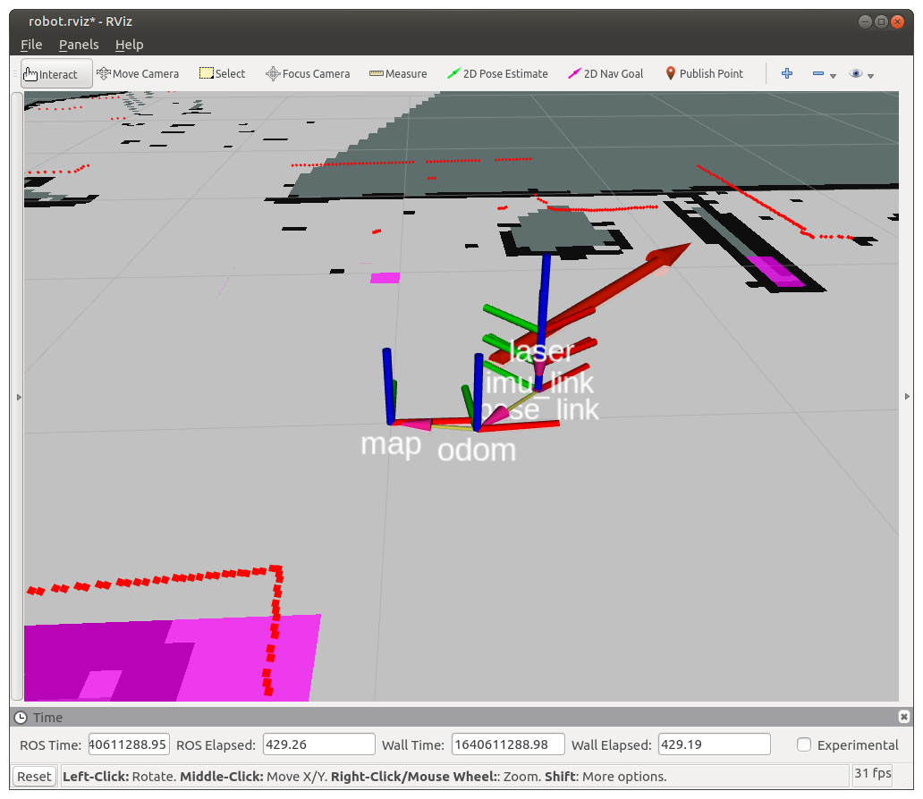
Coordinate Frames of our Robot
Notes:
<number>

Slide 32
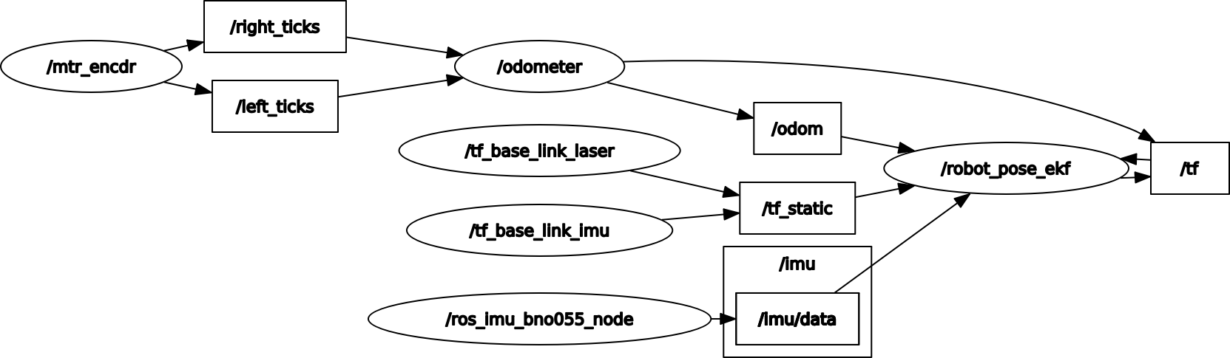
Node-Topic graph for our simple robot
Notes:
<number>

Slide 33
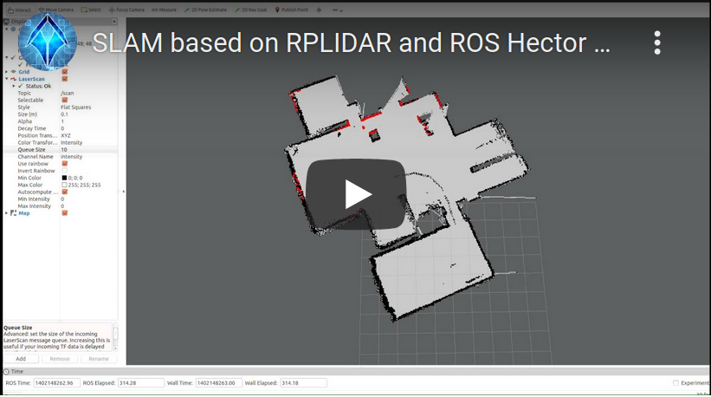
How the robot builds the map
video
Notes:
<number>

Slide 34
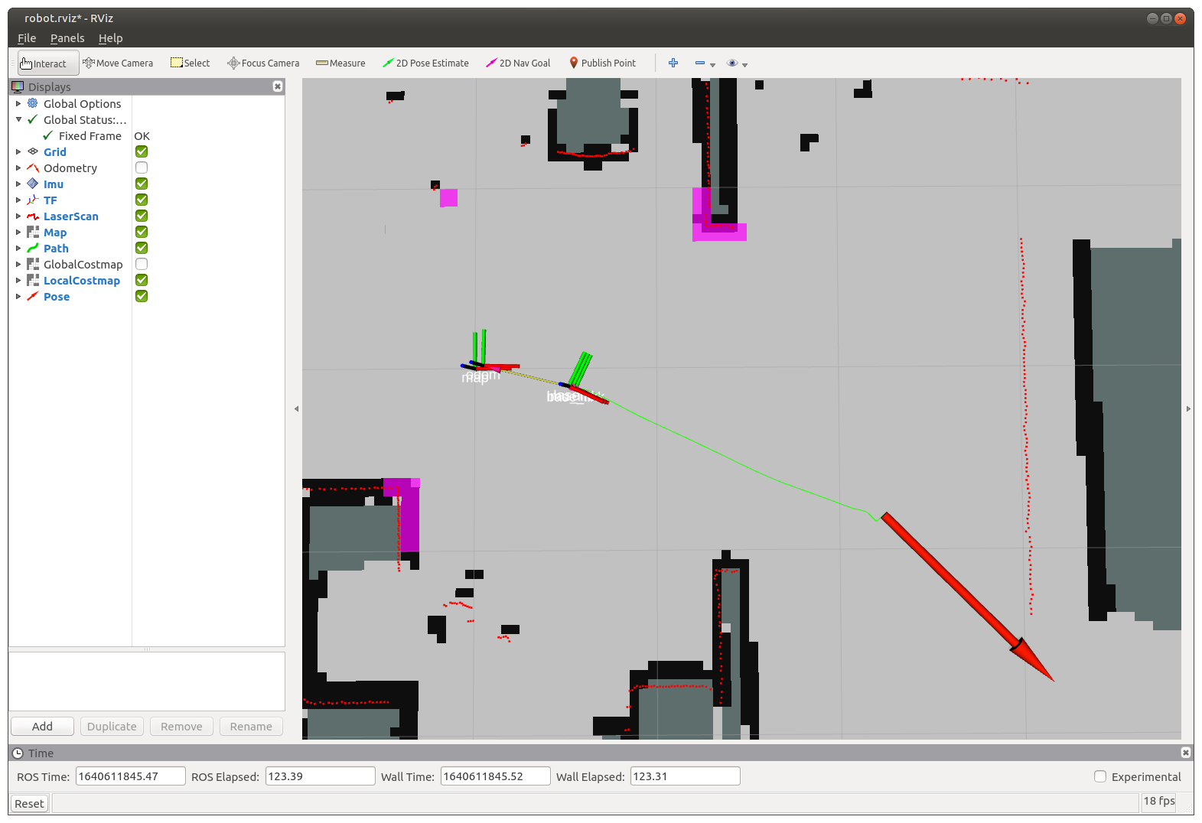
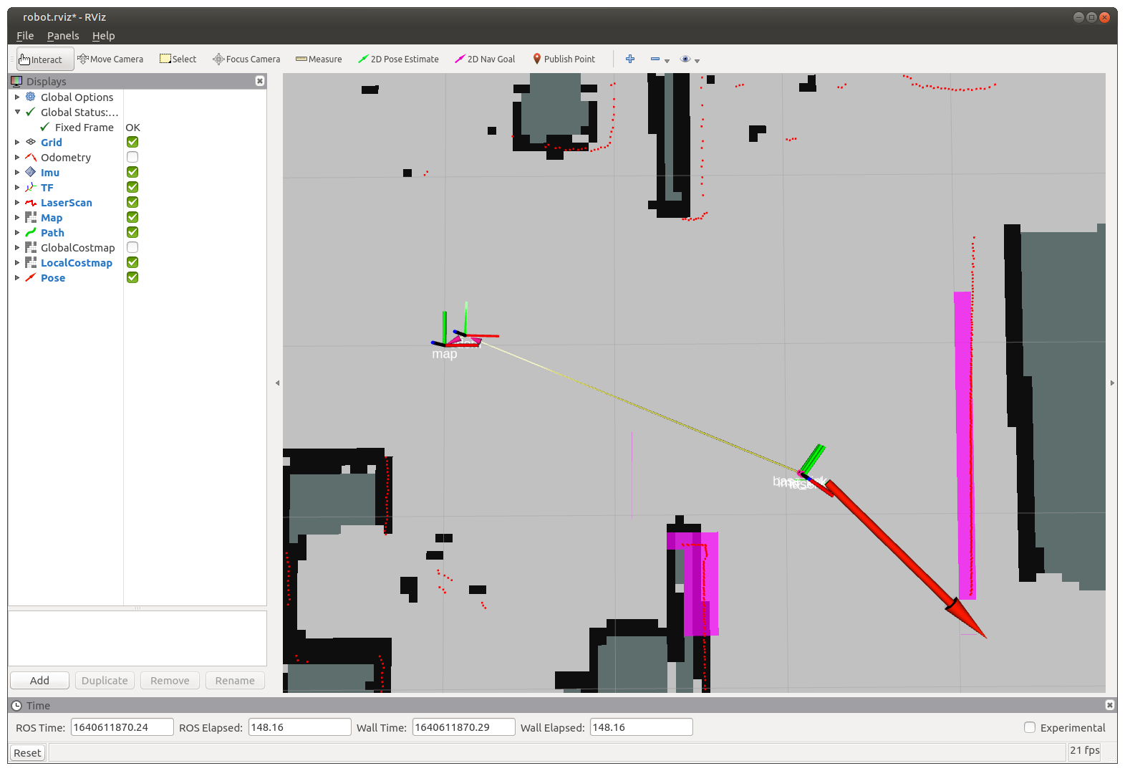
Path Planning
Notes:
<number>

Slide 35
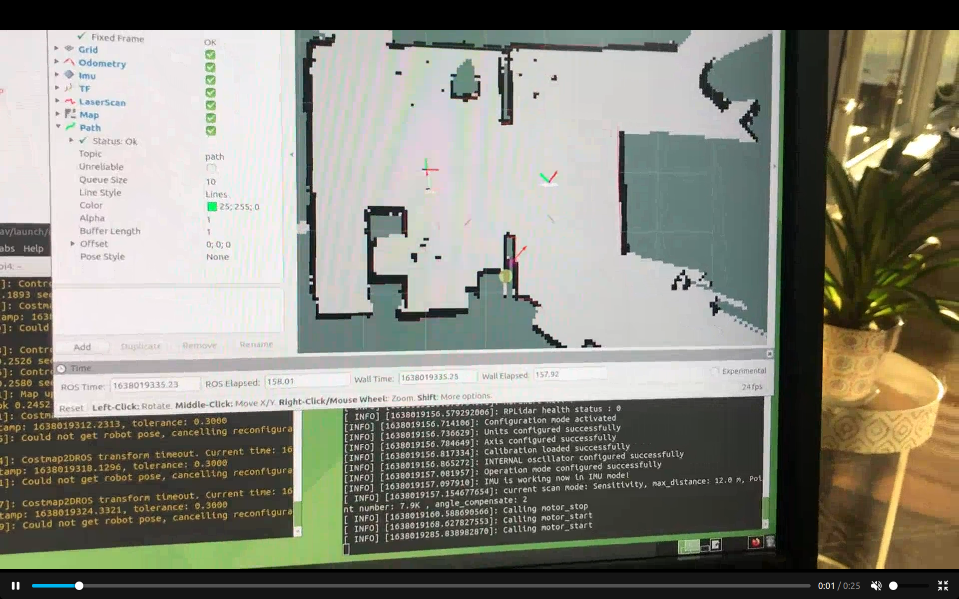
The robot drives to Goal Pose
video
Notes:
<number>

Slide 36
Now let’s ask again: What is ROS?
Not an OS, but a middle-ware
Currently runs best on linux (Ubuntu LTS)
Defacto standard in robotics community
Handles communication between processes called “Nodes”
Nodes can be stopped/started on the fly
Nodes can run on different computers
Distribution of processing load
Collaboration between robots
Notes:
<number>

Slide 37
ROS releases are in “Lock step” with Ubuntu LTS
Although ROS is available on many different operating systems, It is “best” used on the latest version of Ubuntu LTS (Long Term Support).
Currently: ROS “Noetic” running on Ubuntu 20.04 LTS
Notes:
<number>

Slide 38
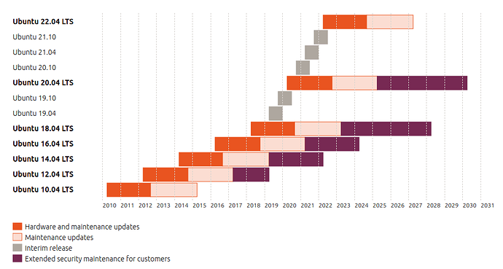
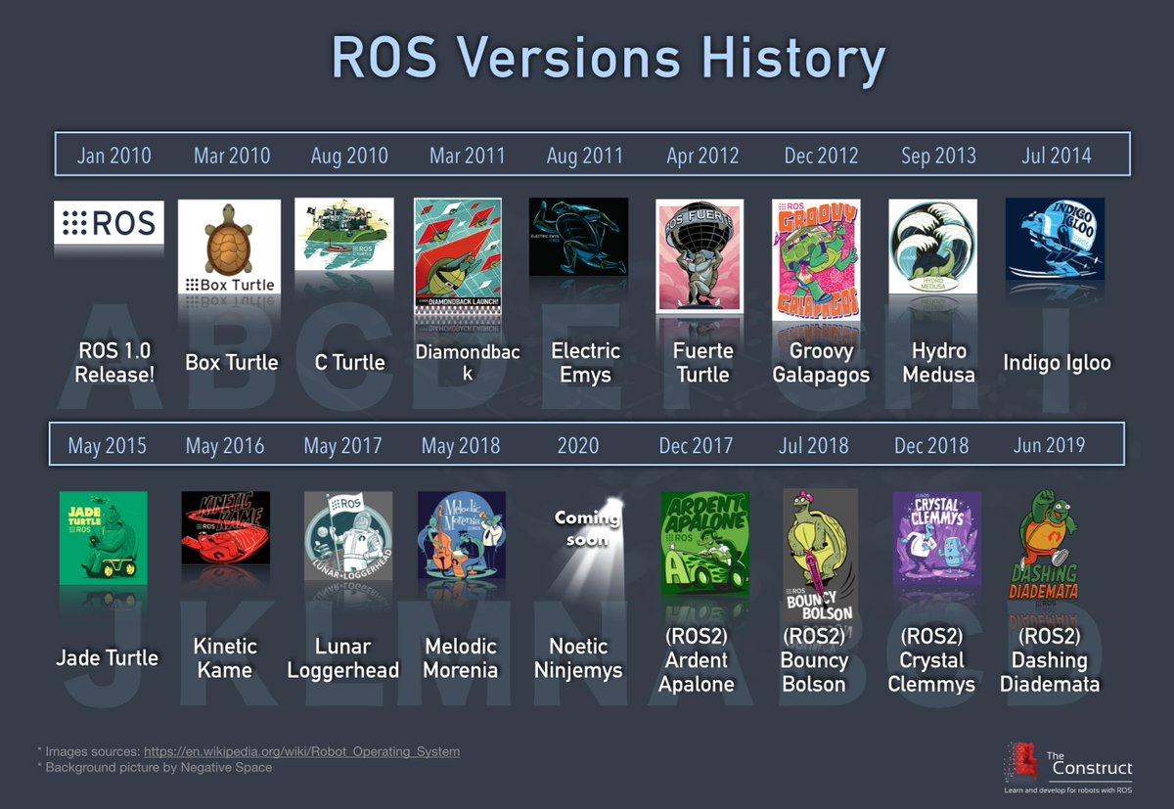
ROS releases are in “Lock step” with Ubuntu LTS
Notes:
<number>

Slide 39
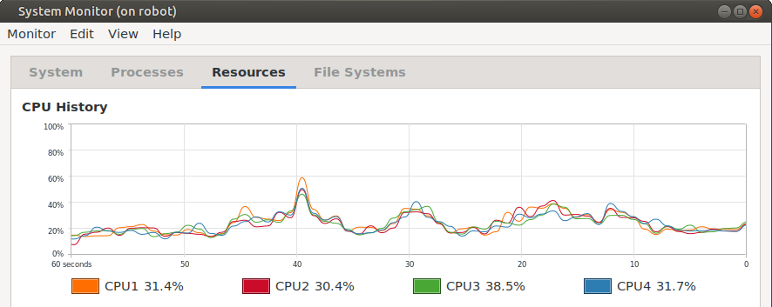
ROS runs “easily” on my 2 RasPi’s
RVIZ running on “Desktop” RasPi 4 w/ 8GB Ram
All other nodes running on robot RasPi 3B+
Notes:
<number>

Slide 40
Installing and learning ROS
http://wiki.ros.org has detailed installation instructions and tutorials
A repository for this project is available at https://github.com/dblanding/diy-ROS-robot
Notes:
<number>

Slide 41
Other Learning resources
Online tutorials at wiki.ros.org/tutorials
Automatic Addison online tutorials
Book: Practical Robotics in C++ by Lloyd Brombach
Robot Ignite Academy
Digital Book: ROS_Robot_Programming_EN.pdf
Notes:
<number>

Slide 42
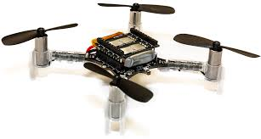
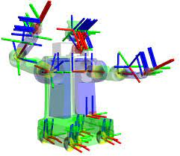
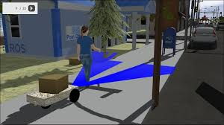
Other things ROS does...
Drones
Articulated Robots
Simulation
Notes:
<number>

